Slide 1



Beehive Monitoring System UT Dallas Office of Sustainability
Ruben Thomas-CS , Lisa Chen-CS, Guaidi Morado-CS,, Shuhrat Choudhury-CE, Sohila Elfar-BMEN, Ava Romberg-CS
Fall 2021

Slide 2
TABLE OF CONTENTS
01
02
03
Accomplishments and Future Plans
Introduction and Project Partner
Problem Description and Impact
Notes:
Note to self: Check to see if there’s a time limit on our presentation to determine if we can keep this slide, since this is basically going to be like a science fair

Slide 3

Project Partner
Project Partner: UT Dallas Office of Sustainability
Mission: Engage UT Dallas as a catalyst and champion for environmental stewardship and social responsibility while fostering a culture of sustainability.
Notes:
introduce office of sustainability and their mission lisa

Slide 4
INTRODUCTION
Project Goal: Create a system that can remotely monitors the activity of bees, at the UT Dallas North Apiary, on the UT Dallas’ sustainability website without disturbing the colonies.
Notes:
Note to self: Project goal label is not required but the stuff after it is.
overview of overall problem to solve, easy to understand and clear

Slide 5
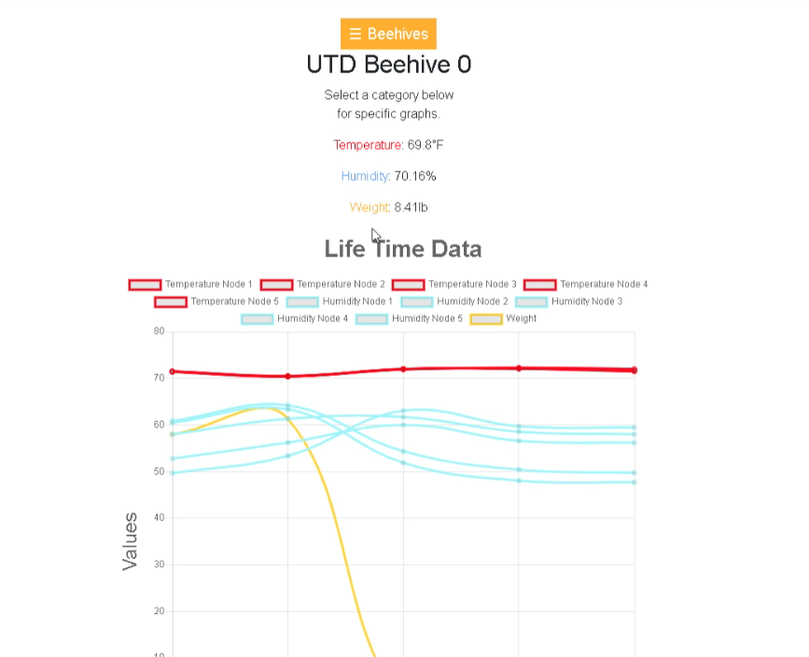
Project
Website supports multiple beehives
Website display graphs showing changes in the temperature, weight and humidity of the beehives over time at regular intervals
Website data obtained from the beehive’s microcontroller and sensors
Notes:
Problem description: overview of overall problem to solve, easy to understand and clear

Slide 6
Impact
Ease project partners workload with UT Dallas beehive’s by monitoring state of beehive’s for them
Allows for conveying to the community the state of UT Dallas Beehives as time goes on.
Autonomously provides data on beehive’s weight, temperature and humidity throughout the year
Notes:
Impact of problem

Slide 7
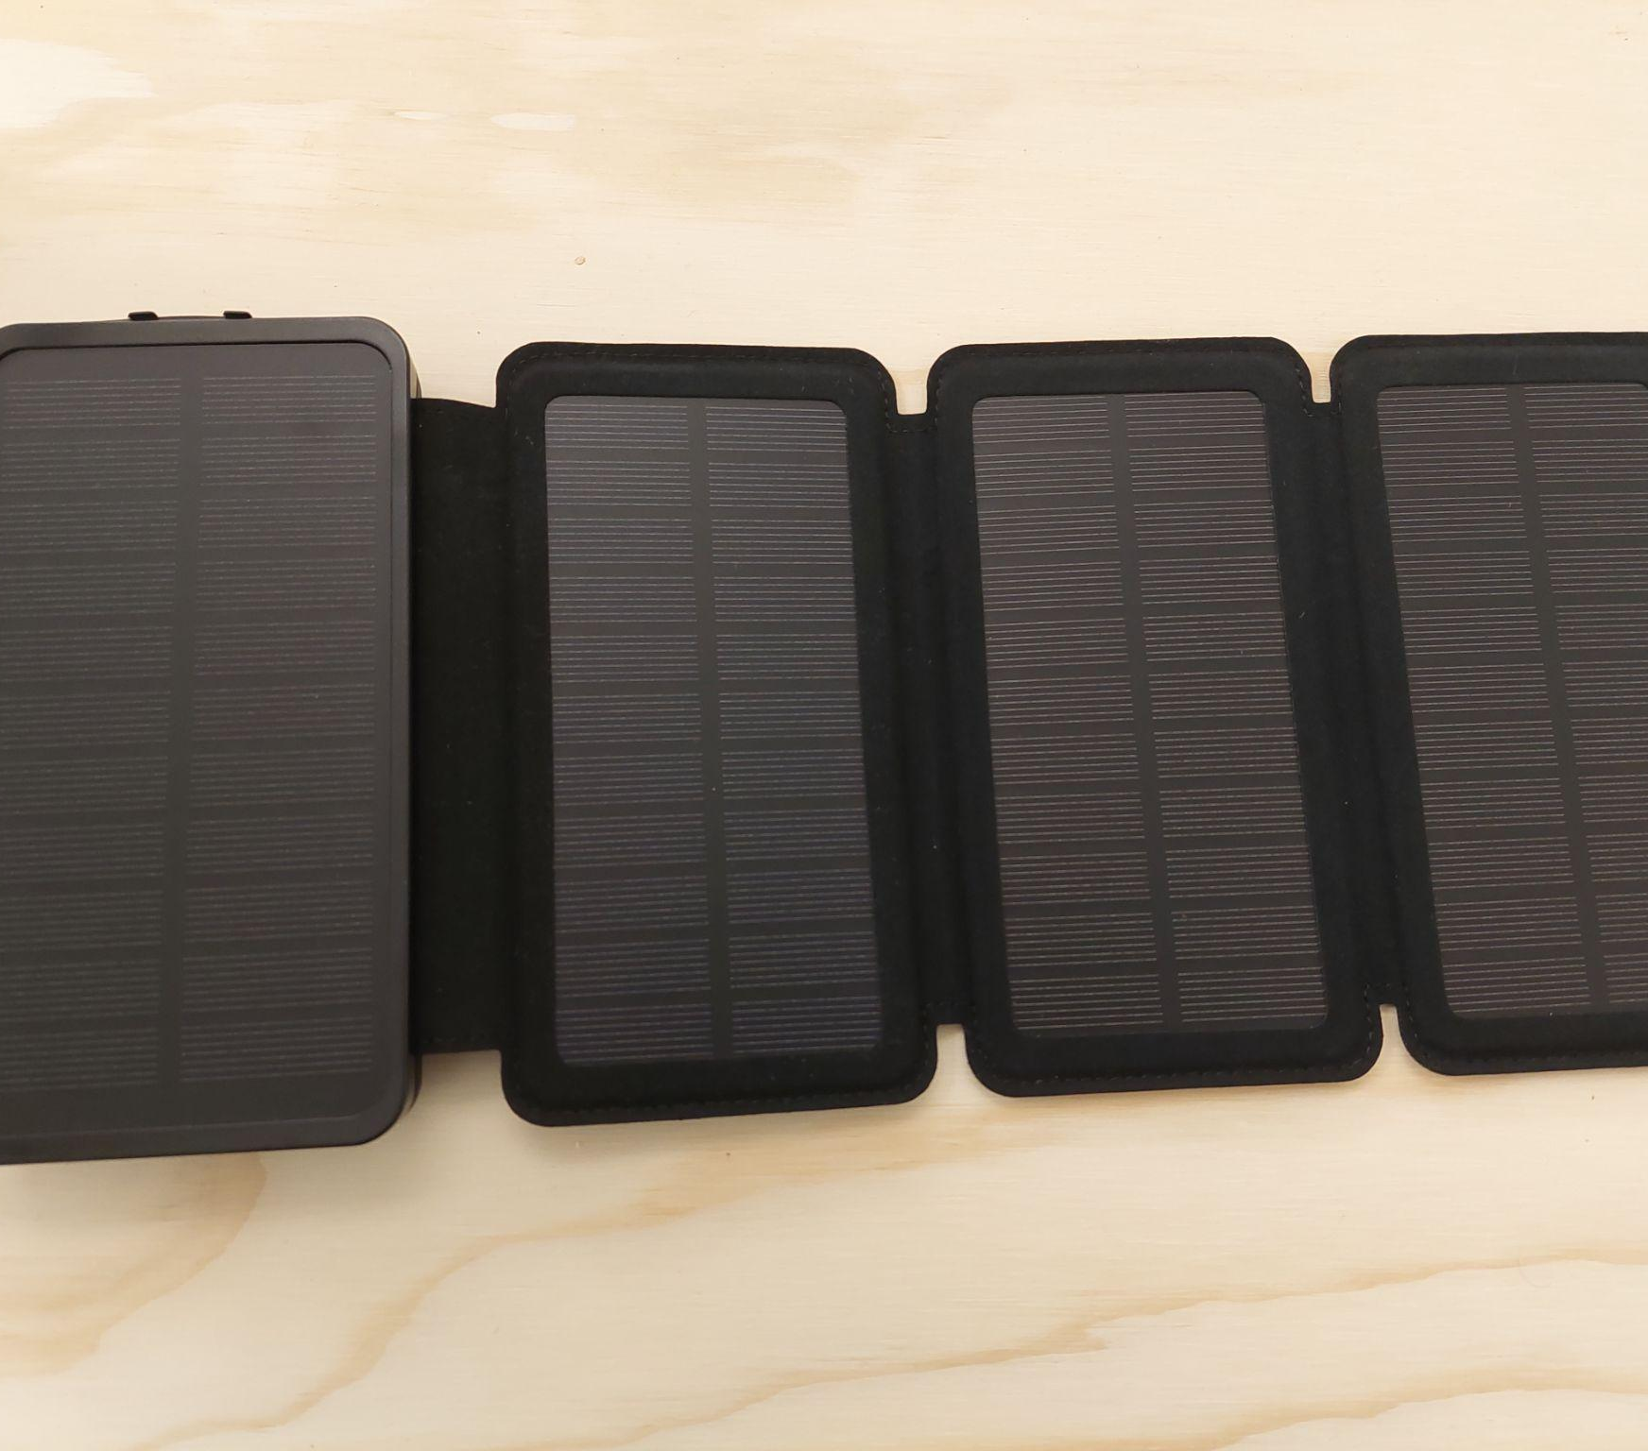
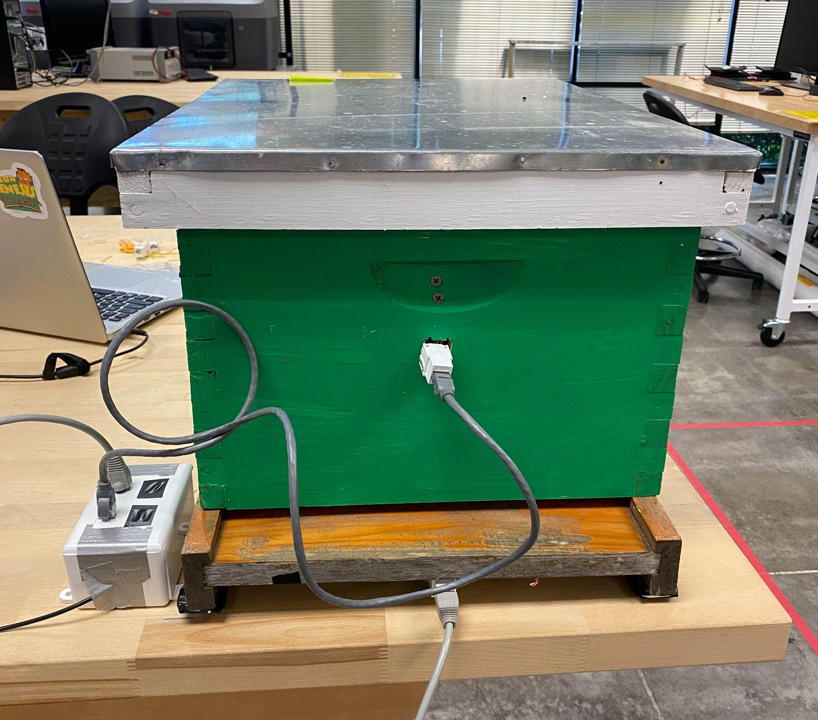
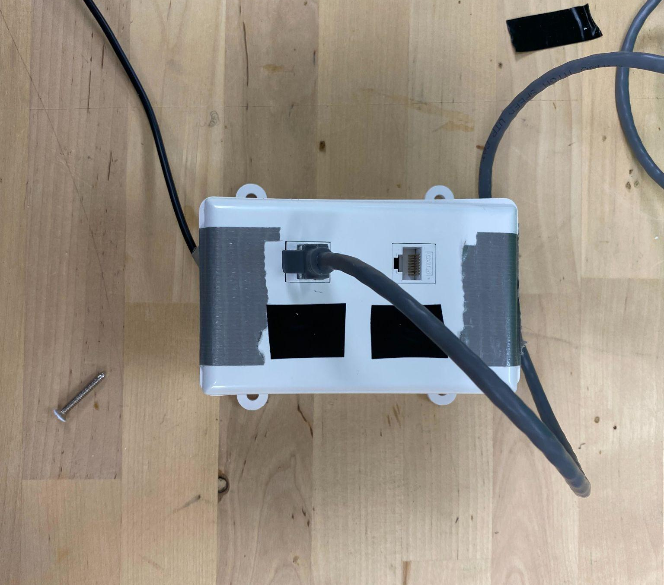
Accomplishments
Installed Solar Panels
Prototyped wire protection and weatherproofing system
Designed new wire setup
Data from ESP32 and sensors set to be displayed as easy to read graphs on accessible website
Repaired installed sensors and ESP32 microcontroller set to collect and send temperature, humidity and weight data on regular basis
Notes:
Accomplishments: clearly say what accomplishments we made

Slide 8
Future Plans
Finesse wiring setup
Finalize Hive Prototype
Polish Hive Design
Create User Manual
Additional Field Testing
Publish Website
Notes:
Future plans: talk about what next steps are for the next semester clearly

Slide 9
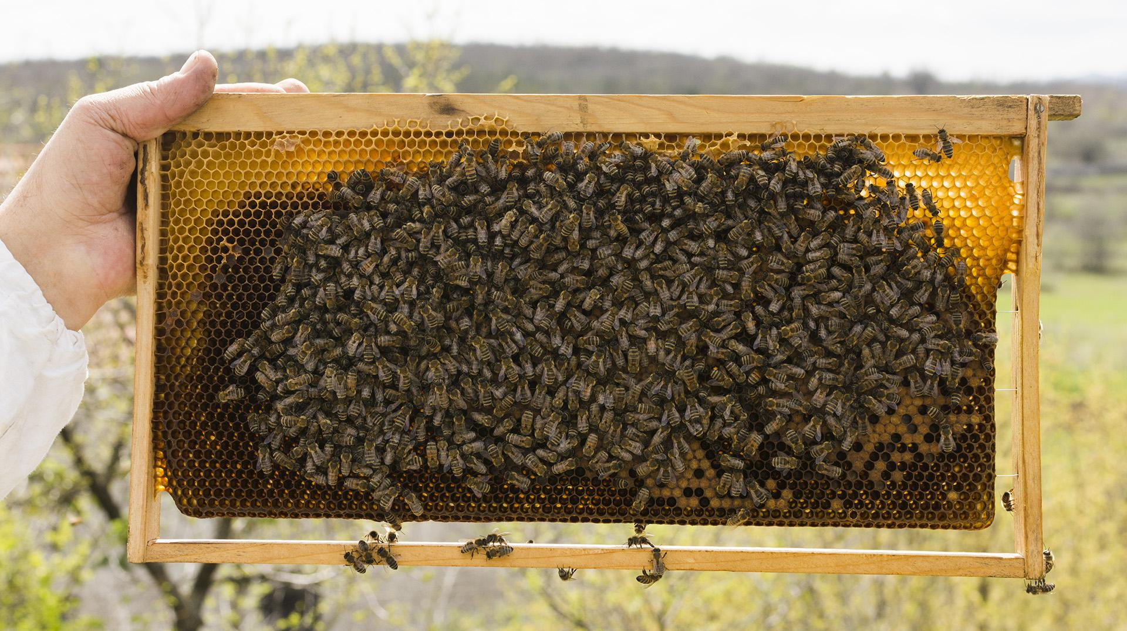
Questions?

